Slide 1
lecture 2: Introduction to Machine Learning
Instructor: Yang Xu
Slides adopted from Xiaobai Liu

Slide 2
Annoucement
Course assignment
6 times
Due Friday midnight, see syllabus
Final project
Up to 6 people

Slide 3
Review: Machine Learning Tasks
Spam email detection
Book recommendation
Financial forecasting
Face recognition
Scene understanding
Self-driving car
Natural language generation
…

Slide 4
Outline
Data Representation
Unsupervised & Supervised Learning
Types of Machine Learning problems

Slide 5
How to develop a Machine Learning system?
First step, represent the data properly

Slide 6
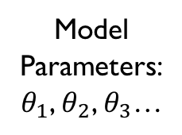
Mental Model
Question: how to represent the data?
Short answer: need features!
Tasks:
Predict spam/not, housing price etc.
Data
Data
Data
Learning/training
Data
Data
Data
Model Parameters:
$θ_{1}$, $θ_{2}$, $θ_{3}$…
New data
Data
Data
Data
Data
Data
Data
Data
Data
Data

Slide 7
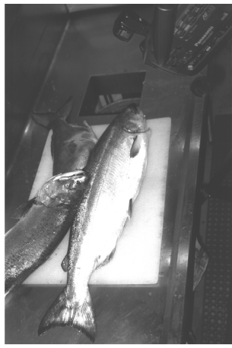
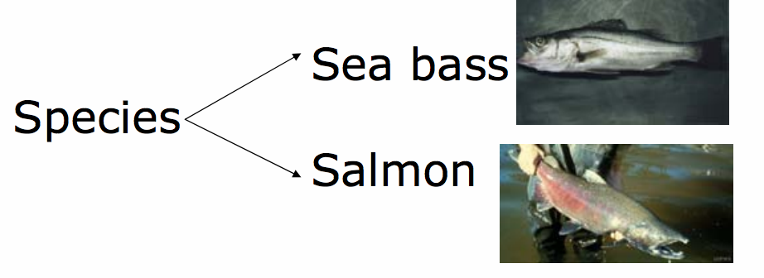
Example Task: Fish Classification
Given a fish, can you tell it is a Salmon or See-bass?

Slide 8
How to?
You are allowed to measure, observe, and touch them.
To answer this question, we need to learn expertise
From your parents
From your friends
From your textbook
Google it
…

Slide 9
What if?
You are asked to learn it on your own:
given a bag of fish, denoted as Bag, you are allowed to measure, observe, and touch them.
For every fish in Bag, you know its class
Could you figure out how to train yourself?
We need features!

Slide 10
Get your hands dirty
For every fish in Bag, measure its length.

Slide 11
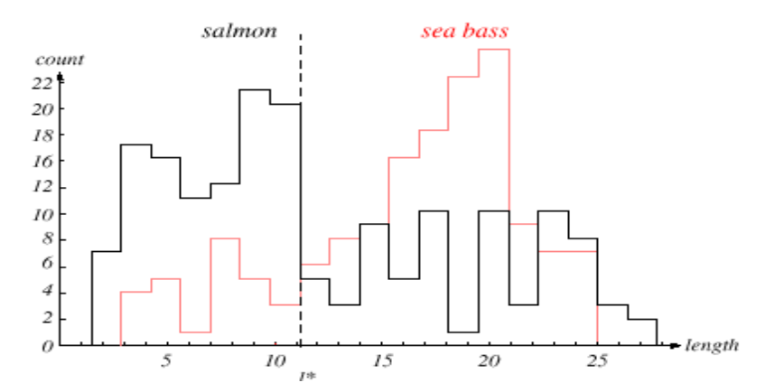
Plot what you got (histogram)
count
length
Empirical boundary: separate a majority of fishes

Slide 12
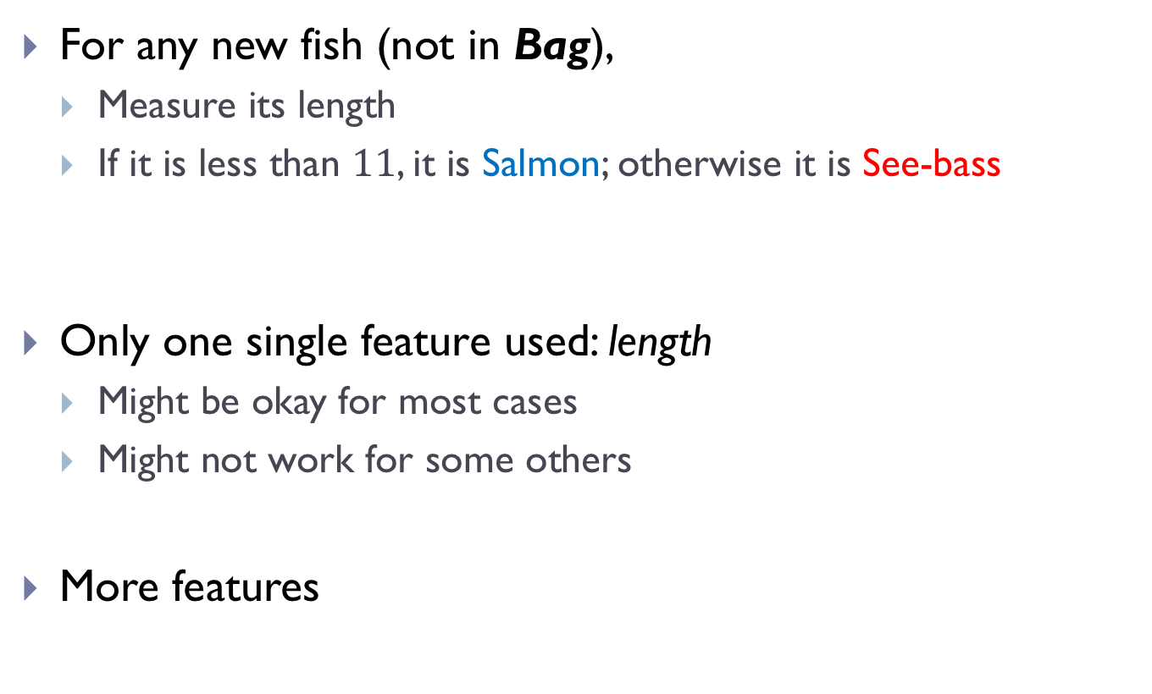
With your expertise
For any new fish (not in Bag),
Measure its length
If it is less than $11$, it is Salmon; otherwise it is See-bass
Only one single feature used: length
Might be okay for most cases
Might not work for some others
More features

Slide 13
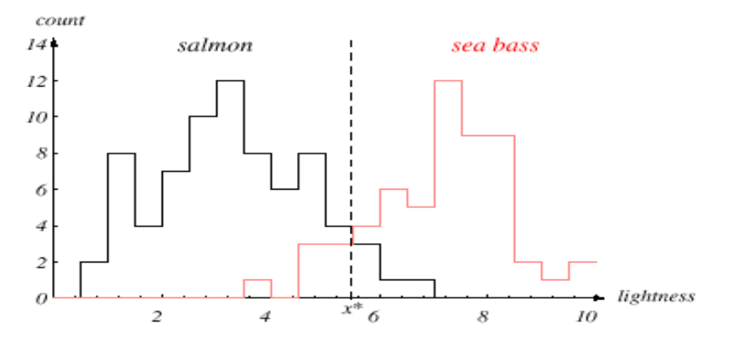
Another feature: lightness
For any fish in Bag, measure its lightness.
Empirical boundary: separate a majority of fishes

Slide 14
With your expertise
For any unseen fish (not in Bag),
Measure its length
If it is less than “11”, it is Salmon; otherwise it is See-bass
Measure its lightness
If it is less than 5.5, it is Salmon; otherwise, it is See-bass

Slide 15
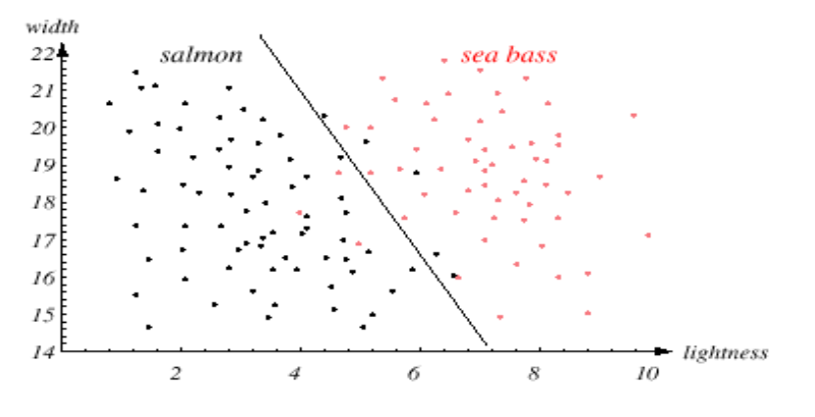


Putting two features together
length
$$[6.8, 20.0]$$
$$[2.1, 16.5]$$
Now, features become a 1-d vector of size 2, [lightness, length]

Slide 16
Be careful
features are not equally well
E.g., number of eyes?
Think about any other features that are useless to separate fish types?

Slide 17
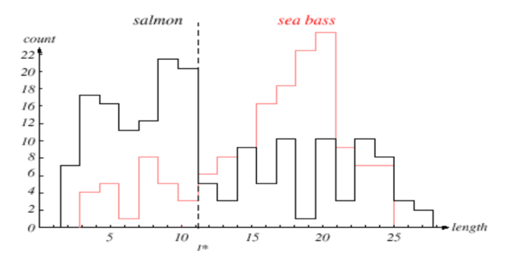
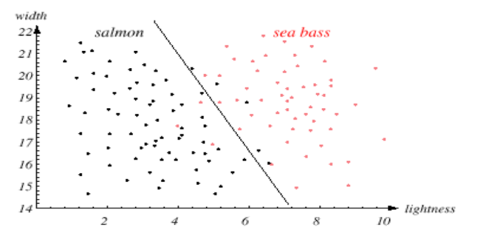
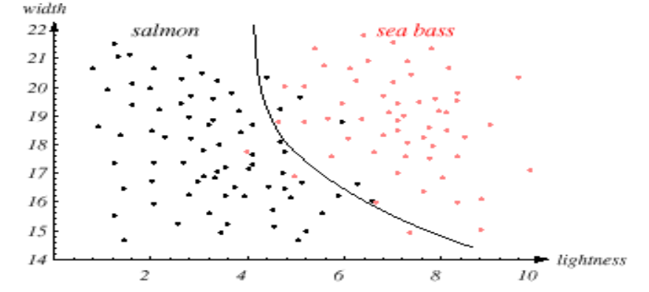
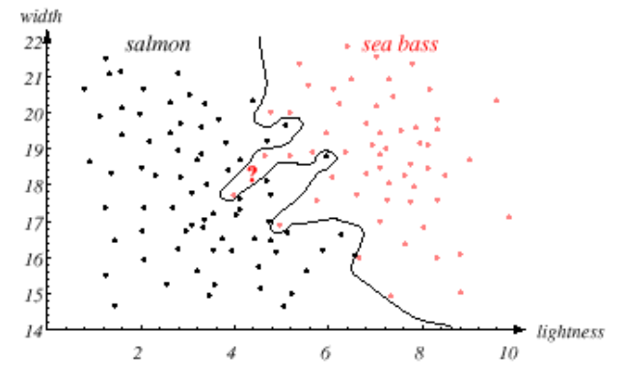
More Advanced ML Models
Is this the best model?

Slide 18
Recap: fish classifier
Choose Features, e.g. length, lightness
Collect training data: a Bag of fish
Represent data instances by feature vectors
Choose a Model (boundaries)
Train the model from training data
Classify new examples using the estimated model
Advanced Machine Learning methods can learn which feature is the most important one (feature selection) and decide which data to collect

Slide 19
Example Conti.
Training data
features, i.e., a vector of measurements, e.g., weight, length, color, of each fish
binary labels for each fish, e.g. for salmon, or for sea bass
Given a novel test example
Compute feature vector x;
Predict label y

Slide 20
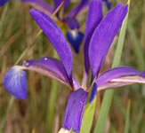
Case: Flower Classification
Database : https://archive.ics.uci.edu/ml/datasets/Iris
Flower Types:
-- Iris Setosa -- Iris Versicolour -- Iris Virginica
1. sepal length in cm 2. sepal width in cm 3. petal length in cm 4. petal width in cm
[sepal_length, sepal_width, petal_length, petal_width]
Vector size = 4

Slide 21
Case: Autistic Spectrum Disorder (ASD)
Dataset: https://archive.ics.uci.edu/ml/datasets/Autism+Screening+Adult#
704 subjects
21 features
Classify a person to be positive (with ASD) or negative (without)
Feature vector of size 21

Slide 22
Attribute | Type | Description
Age | Number | Age in years
Gender | String | Male or Female
Ethnicity | String | List of common ethnicities in text format
Born with jaundice | Boolean (yes or no) | Whether the case was born with jaundice
Family member with PDD | Boolean (yes or no) | Whether any immediate family member has a PDD
Who is completing the test | String | Parent, self, caregiver, medical staff, clinician ,etc.
Country of residence | String | List of countries in text format
Used the screening app before | Boolean (yes or no) | Whether the user has used a screening app
Screening Method Type | Integer (0,1,2,3) | The type of screening methods chosen based on age category (0=toddler, 1=child, 2= adolescent, 3= adult)
Question 1 Answer | Binary (0, 1) | The answer code of the question based on the screening method used
Question 2 Answer | Binary (0, 1) | The answer code of the question based on the screening method used
Question 3 Answer | Binary (0, 1) | The answer code of the question based on the screening method used
Question 4 Answer | Binary (0, 1) | The answer code of the question based on the screening method used
Question 5 Answer | Binary (0, 1) | The answer code of the question based on the screening method used
Question 6 Answer | Binary (0, 1) | The answer code of the question based on the screening method used
Question 7 Answer | Binary (0, 1) | The answer code of the question based on the screening method used
Question 8 Answer | Binary (0, 1) | The answer code of the question based on the screening method used
Question 9 Answer | Binary (0, 1) | The answer code of the question based on the screening method used
Question 10 Answer | Binary (0, 1) | The answer code of the question based on the screening method used
Screening Score | Integer | The final score obtained based on the scoring algorithm of the screening method used. This was computed in an automated manner
Number of instances (records in your data set): 704
Number of features (fields within each record): 21

Slide 23
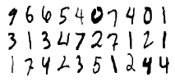
Case: Digit Recognition
10 classes: 0-9
Feature vector size? Dimension?

Slide 24
Data Representation
Notes:
Arthur Samuel (1959). Machine Learning: Field of study that gives computers the ability to learn without being explicitly programmed.

Slide 25
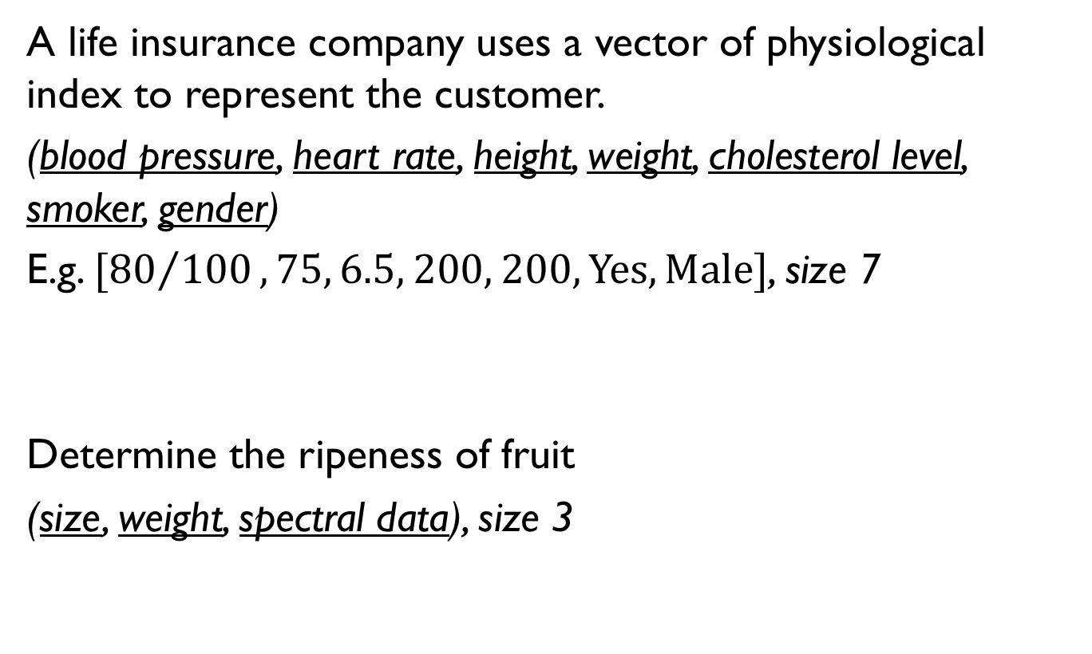
Other examples
A life insurance company uses a vector of physiological index to represent the customer.
(blood pressure, heart rate, height, weight, cholesterol level, smoker, gender)
E.g. $[{80}/{100},75, 6.5, 200, 200,\text{Yes}, \text{Male}]$, size 7
Determine the ripeness of fruit
(size, weight, spectral data), size 3
Notes:
that the scales and units
of di↵erent coordinates may vary widely.

Slide 26
Others
Images
Videos
Trees/Graphs
Strings
Compound Structures

Slide 27
Unsupervised & Supervised Learning
Notes:
Arthur Samuel (1959). Machine Learning: Field of study that gives computers the ability to learn without being explicitly programmed.

Slide 28
Learning: Supervised and Unsupervised
Supervised learning
Training samples are feature-label pairs
Test sample has only features
The task is to predict labels
Unsupervised Learning
Training data includes only unlabeled features;
Task is to cluster data into groups, or reduce dimensionality

Slide 29
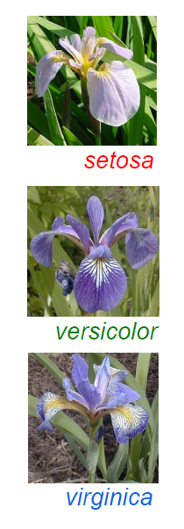
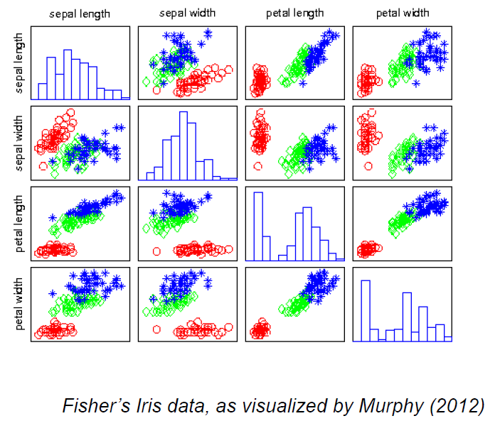
Supervised Classification

Slide 30
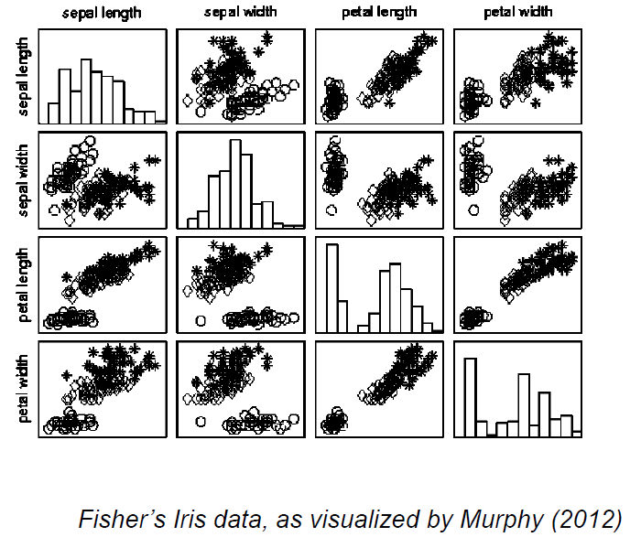
Unsupervised Clustering

Slide 31
Types of Machine Learning Problems
Notes:
Arthur Samuel (1959). Machine Learning: Field of study that gives computers the ability to learn without being explicitly programmed.

Slide 32
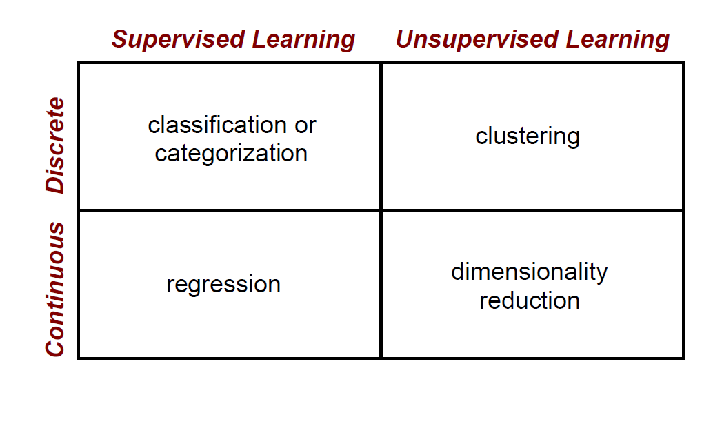
Machine Learning Problems

Slide 33
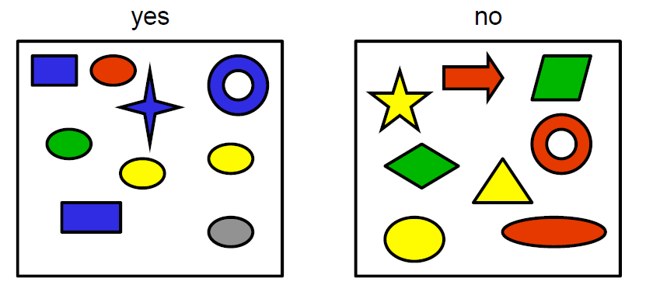

Problem 1: Classification problems
Discrete Supervised Learning
Notes:
Discrete Supervised

Slide 34
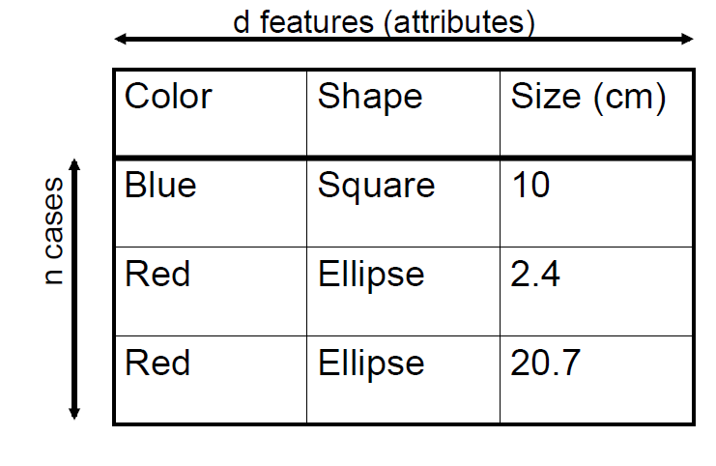

Slide 35
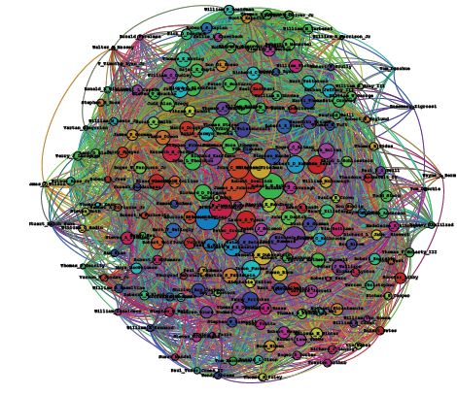
Problem 2: Clustering
Discrete Unsupervised Learning
User Activities
Community Discovery
Large-Scale Issue
Notes:
Discrete Unsupervised

Slide 36
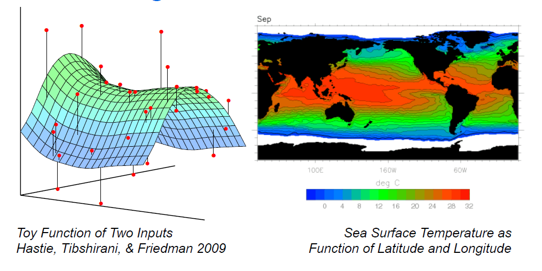
Problem 3: Regression
Continuous Supervised Learning
Label is real number, not discrete classes
Notes:
Continuous Supervised

Slide 37

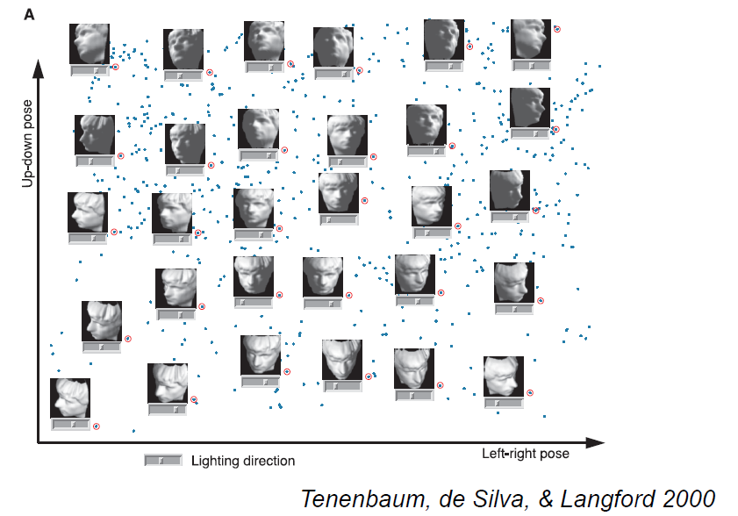
Problem 4: Dimensionality Reduction
Unsupervised Regression
Example: faces
Features of high dimension: 32pixels *32 pixels=1024? 256 gray

Slide 38
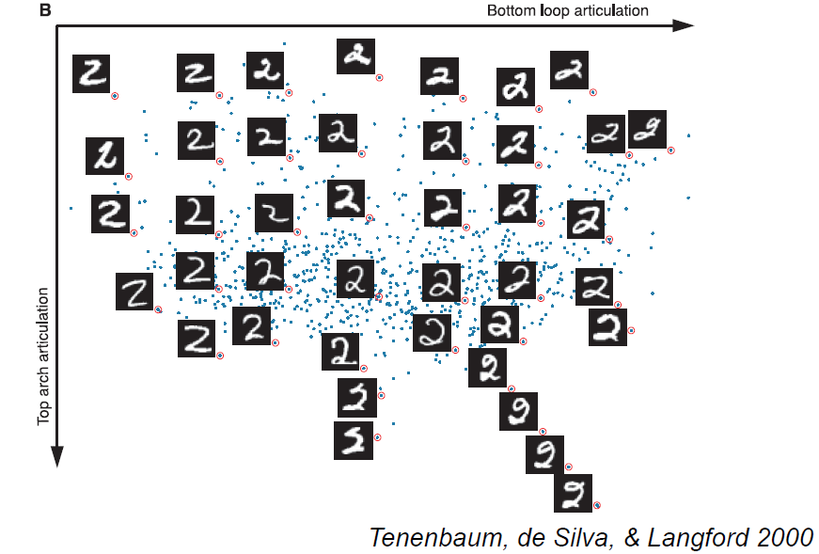
Problem 4: Dimensionality Reduction
Unsupervised Regression

Slide 39
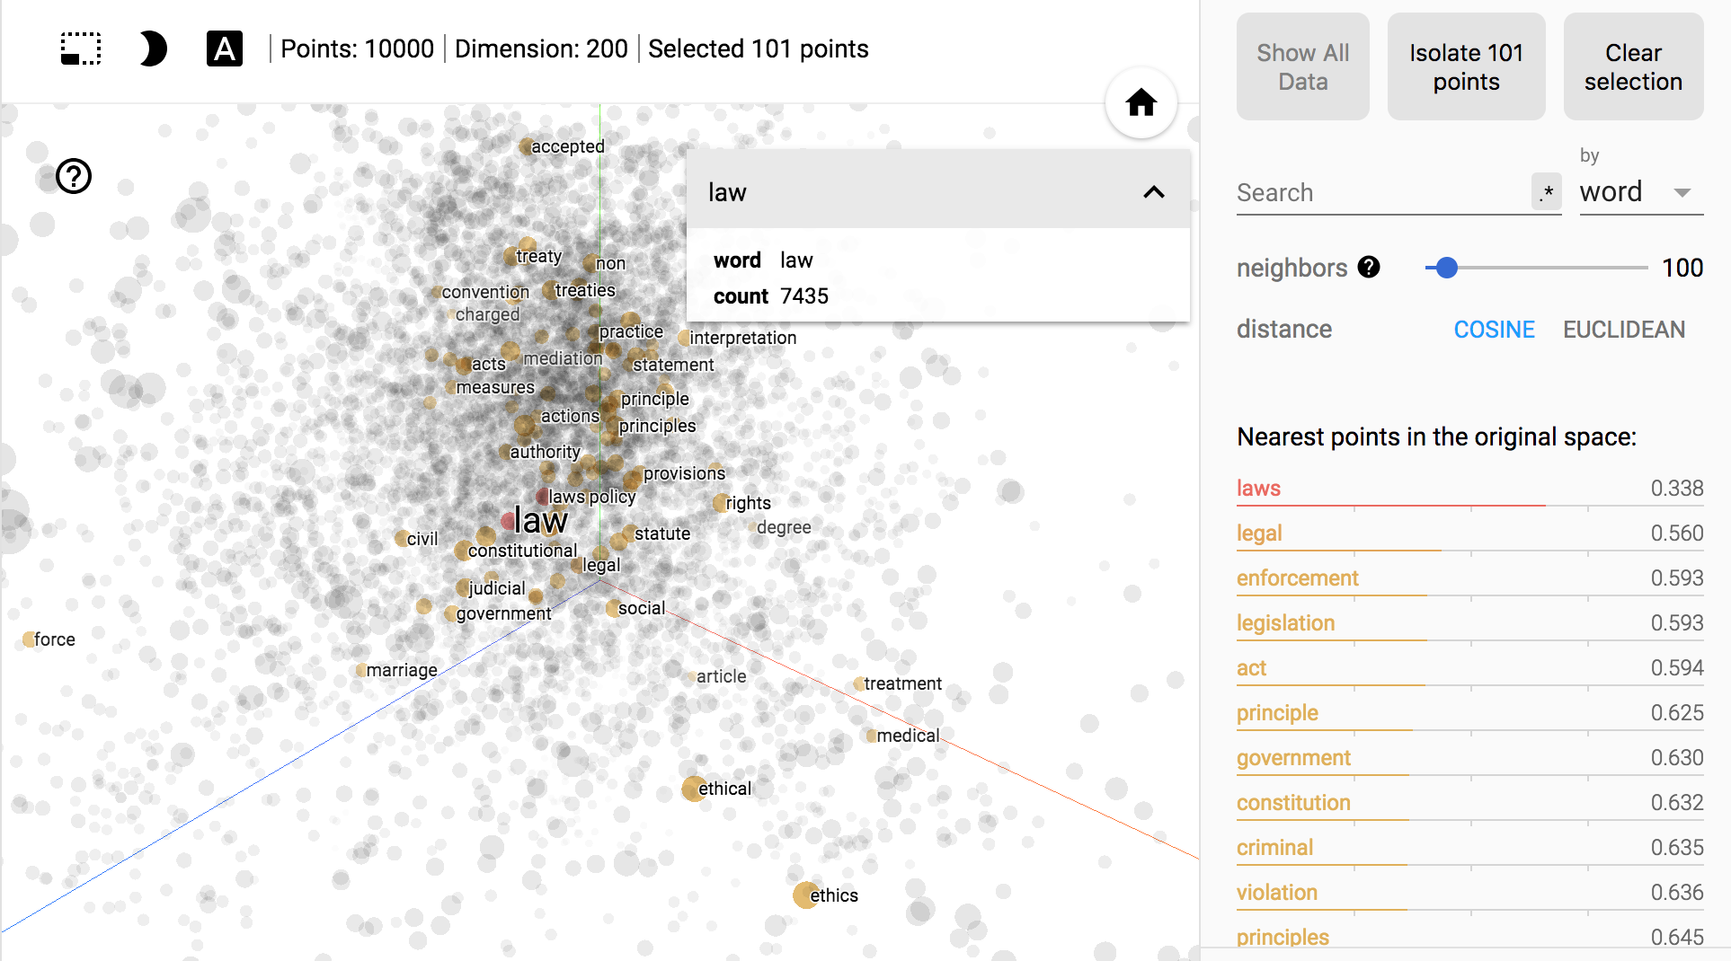
Problem 4: Dimensionality Reduction
Reducing the dimension of word vectors using t-SNE
https://projector.tensorflow.org/

Slide 40
Quiz 1
Of the following examples, which can be well addressed using an unsupervised learning algorithm? (Check all that apply.)
A. Given email labeled as spam/not spam, learn a spam filter.
B. Given a set of news articles found on the web, group them into set of articles about the same story.
C. Given a database of customer data, automatically discover market segments and group customers into different markets.
D. Given a dataset of patients diagnosed as either having diabetes or not, learn to classify new patients as having diabetes or not.

Slide 41
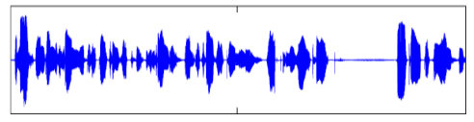
Quiz 2: speech recognition
Which of the following statements are not correct?
A. The training data are audio-word pairs
B. The task is to recognize spoken words for a novel audio waveform
C. This is a unsupervised learning problem
D. This is typical supervised learning problem

Slide 42
Assignment 1 Guide
Q1. Plot four functions
Q2. Choices
Q3. Choices
Q4. Writing
Prepare a single PDF file for all four questions
Source code (.py) for Q1 can be submitted separately
NO HARD COPY IS ACCEPTED
Due 11:59pm, Friday 9/7/2018

Slide 43
Next Lecture
Linear Regression

